Slide 1
IPRP Fault & Seismic Hazard to DCNPP Presentation
Dr. Douglas Hamilton, CEG
November 17, 2014

Slide 2
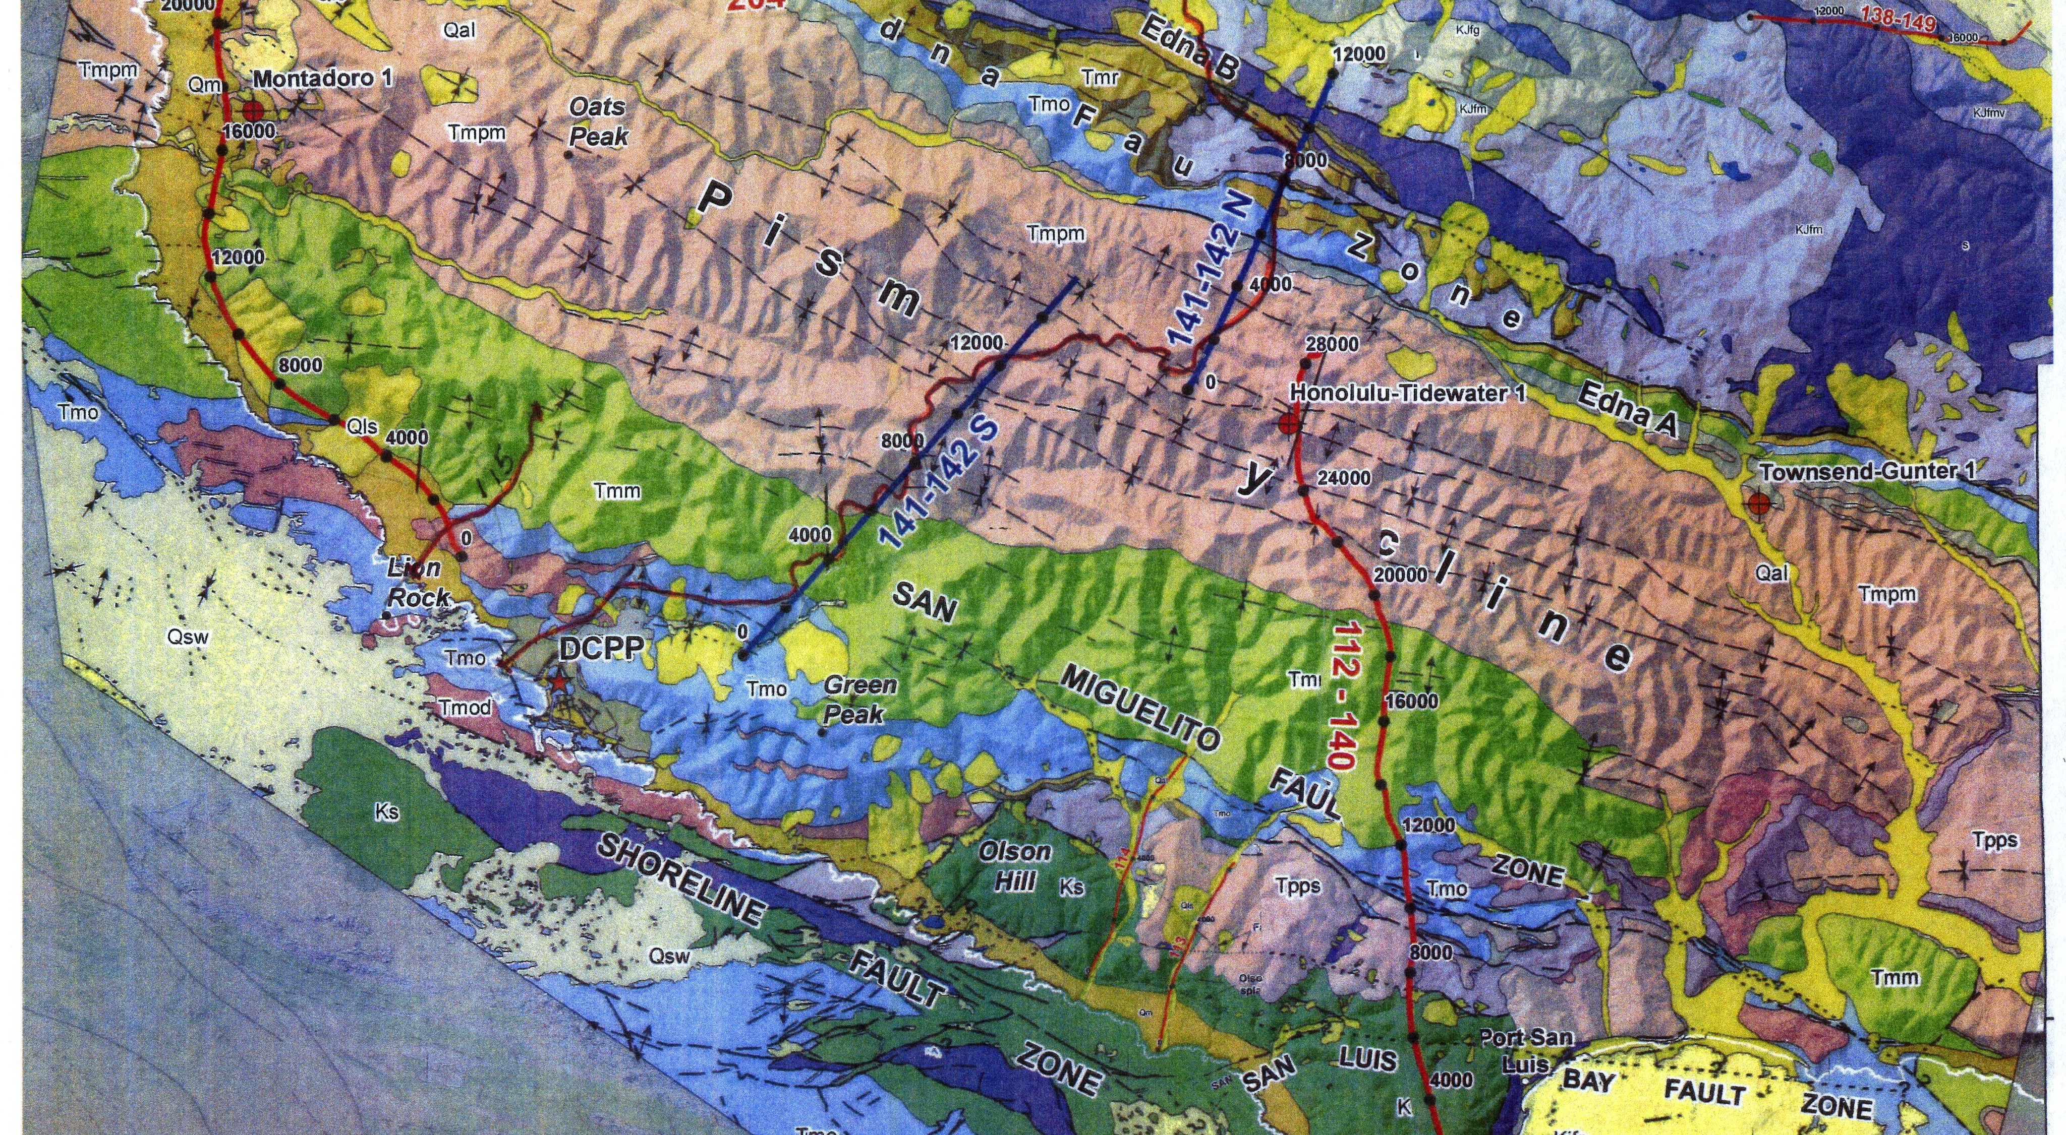

Slide 3
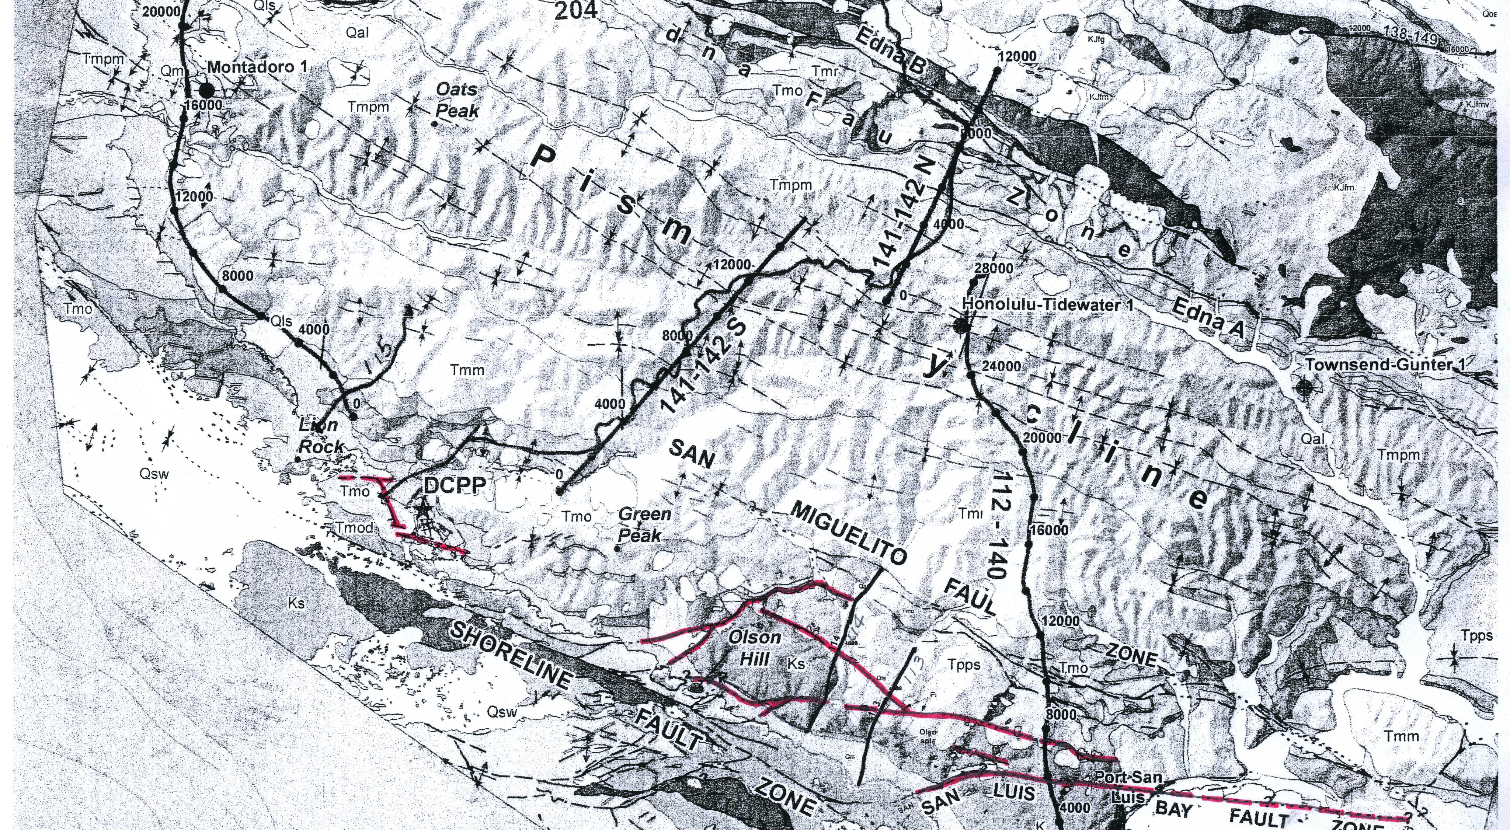

Slide 4
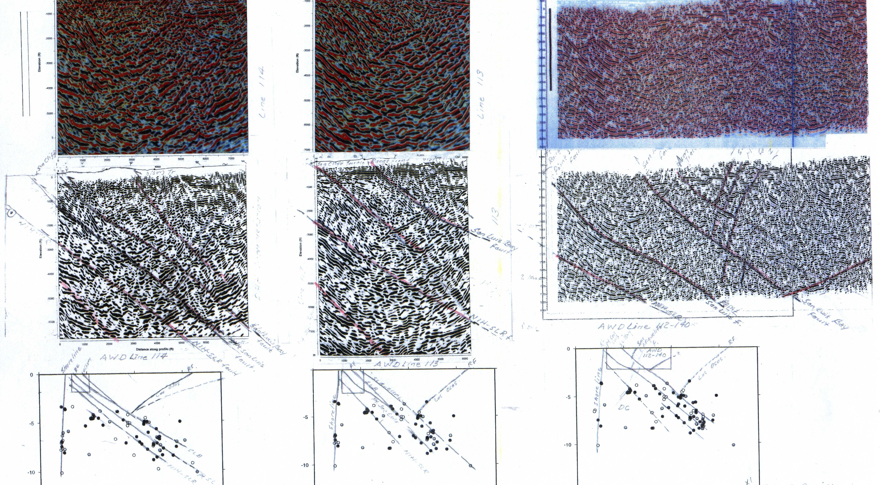

Slide 6
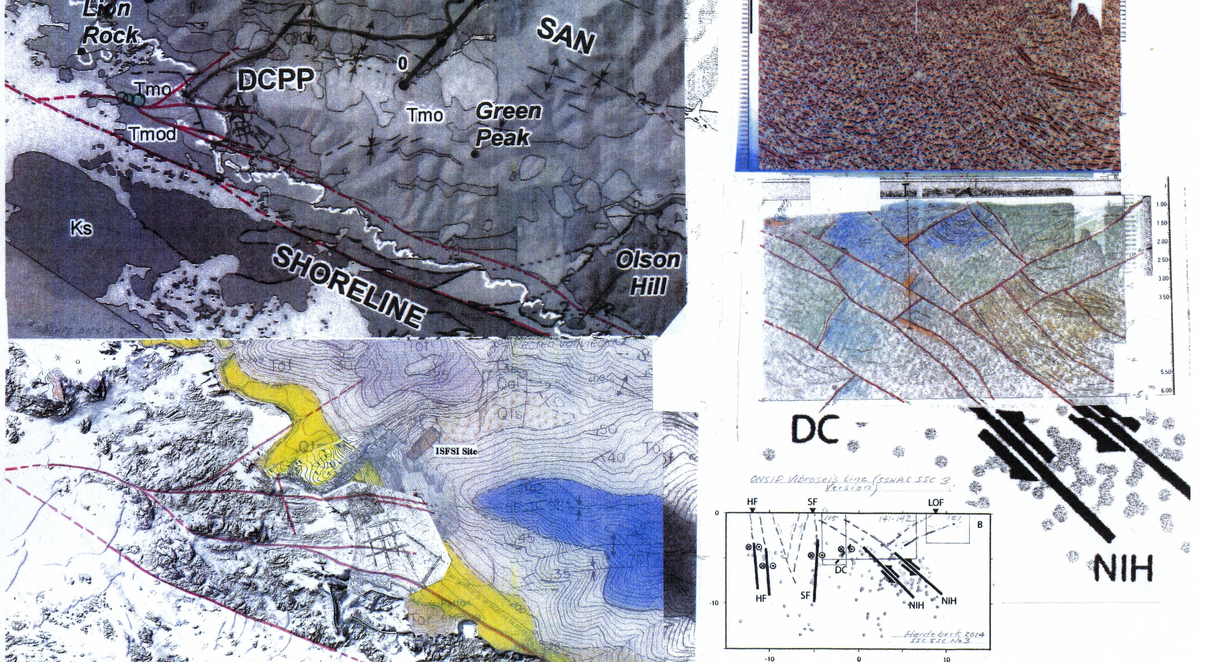

Slide 7
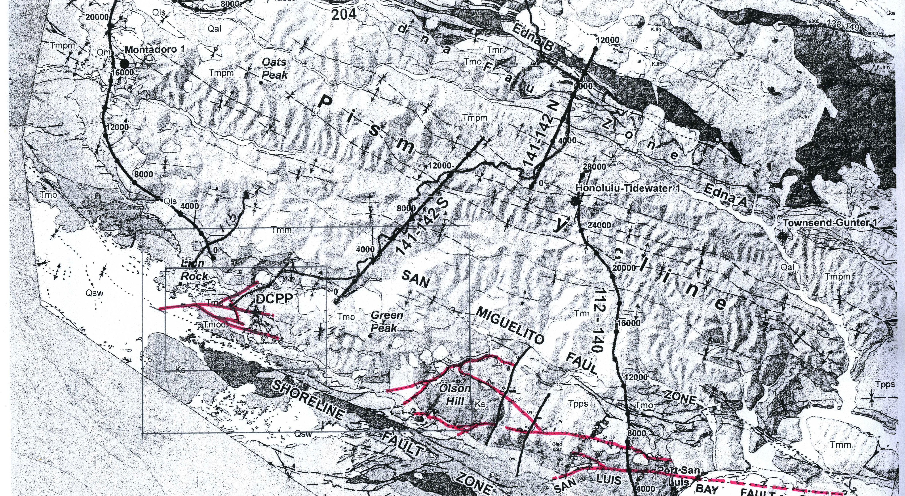

Slide 8
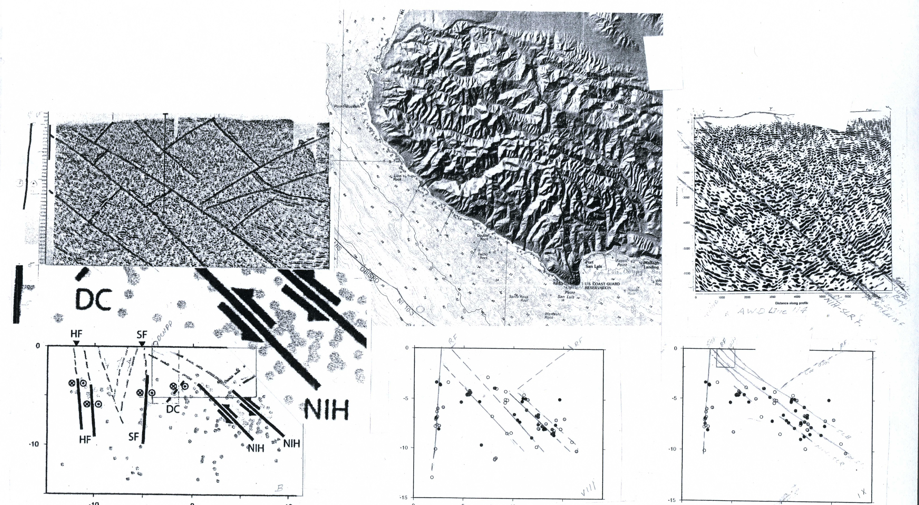

Slide 9
